Slide 1
Theory of Computation
Dr. Sujit Kumar Das

Slide 2
Finite Automata
Components of an Automaton
Every automaton has:
Input alphabet (Σ) – symbols allowed
States (Q) – machine’s memory
Transition function (δ) – rules to move between states
Initial state (q₀) – starting point
Final/accepting states (F) – successful termination

Slide 3
How an Automaton Works
Start at the initial state
Read the input left to right
For each symbol, follow the transition rule
After the entire input is read:
If in an accepting state → accept
Otherwise → reject

Slide 4
Finite Automaton
Definition:
A Finite Automaton is an automaton with finite memory, represented only by states.
Two types finite automata
DFA (Deterministic Finite Automata)
NFA (Non-deterministic Finite Automata)

Slide 5
Example to Explain Automata
Language: All binary strings ending with 1
Σ = {0,1}
States:
q₀: last symbol was 0 or start
q₁: last symbol was 1 (accepting)
Transitions:
q₀ —1→ q₁
q₁ —0→ q₀
q₁ —1→ q₁

Slide 6
Key points to remember
Automata recognize languages, not solve problems
They do not store input
Memory is represented by states
Acceptance depends on final state, not the path

Slide 7
Transition Function (δ)
What is a Transition Function?
A transition function defines how an automaton moves from one state to another when it reads an input symbol.
It is the heart of any automaton (DFA, NFA, PDA, TM).
Transition Function in DFA
δ : Q × Σ → Q
Meaning:
Input to δ = (current state, input symbol)
Output of δ = next state
Example: δ(q0, 1) = q1; If you are in q0 and read 1, move to q1.

Slide 8
DFA Transition Table
δ | 0 | 1
q0 | q0 | q1
q1 | q0 | q1

Slide 9
Grammar (English)
Grammar is a set rules that defines correctness (well formedness)
Typical rules to form a sentence in English is
<sentence> → <noune phrase> <predicate>
<nounphrase>→<article><noun>
<predicate>→<verb>
<article>→ a, an, the
<noun>→ boy, dog, any name
<verb>→ eat, run, sleep etc

Slide 10
Grammar (TOC)
In TOC it is a set of rules to defined language
It is defined as quadruple G=(V, T, S,P)
V is finite set of objects called variables
T is a finite set of objects called terminals
S is part of V. It is a special symbol called start variable
P is a finite set of production
Set V and T are disjoint and nonempty
Production rule is the heart of the grammar, specify how a string is converted to another

Slide 11
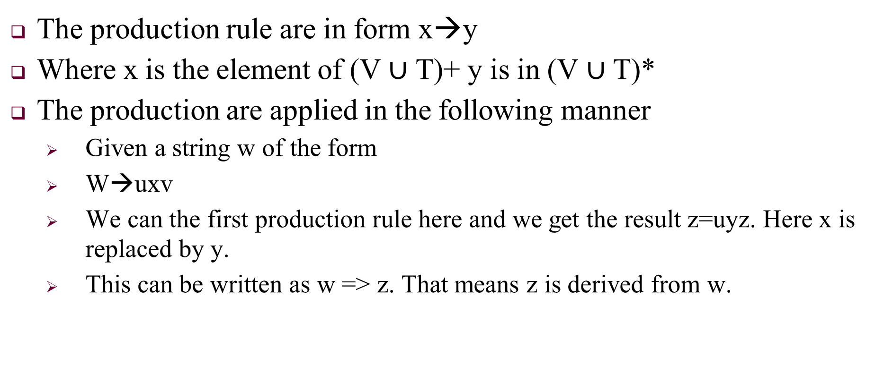
The production rule are in form x→y
Where x is the element of (V $∪$ T)+ y is in (V $∪$ T)*
The production are applied in the following manner
Given a string w of the form
W→uxv
We can the first production rule here and we get the result z=uyz. Here x is replaced by y.
This can be written as w => z. That means z is derived from w.

Slide 12
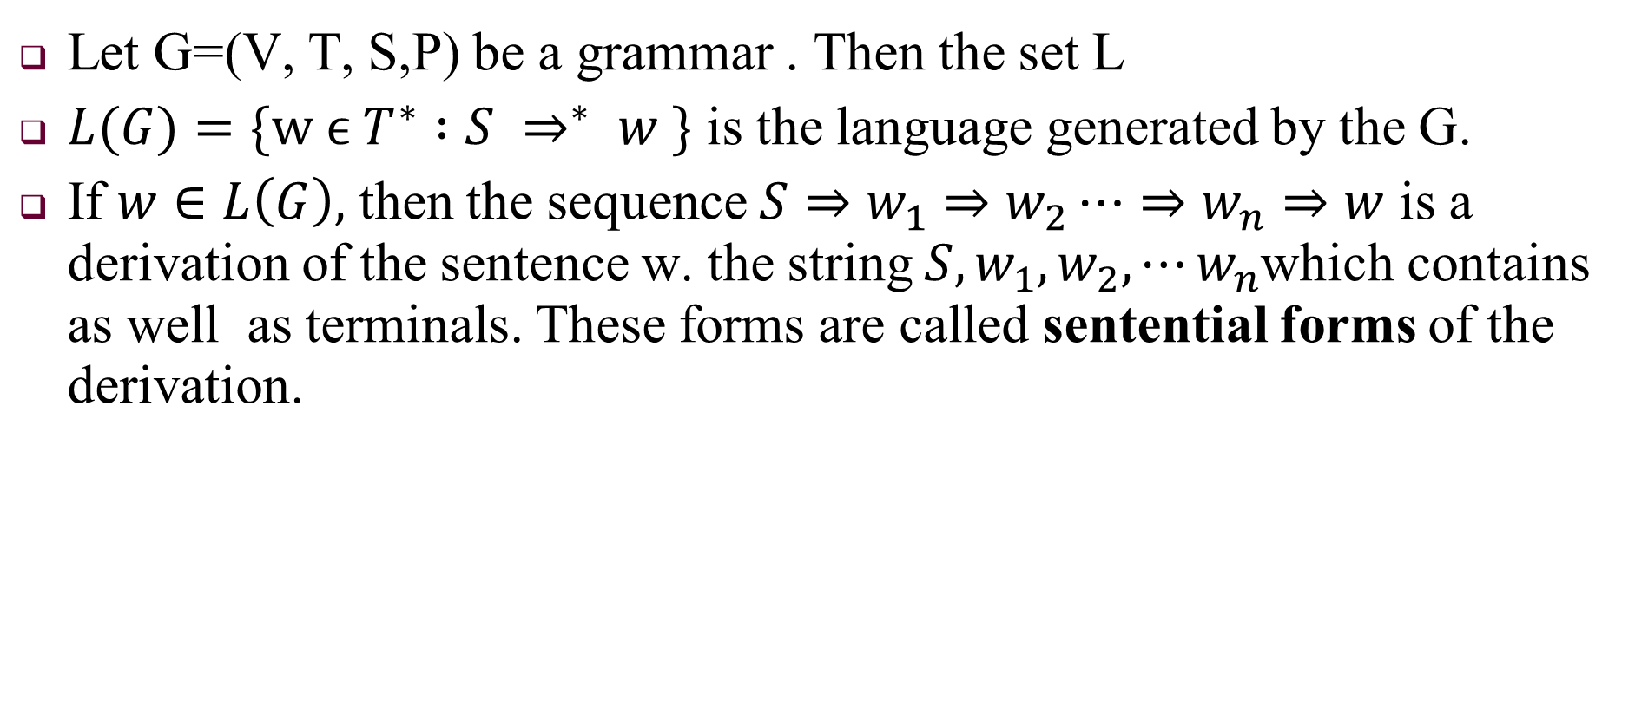
Let G=(V, T, S,P) be a grammar . Then the set L
$L(G)=\{w ϵ T^{∗} :S ⇒^{∗} w \}$ is the language generated by the G.
If $w∈L\left(G\right),$ then the sequence $S⇒w_{1}⇒w_{2}⋯⇒w_{n}⇒w$ is a derivation of the sentence w. the string $S,w_{1}, w_{2}, ⋯w_{n}$which contains as well as terminals. These forms are called sentential forms of the derivation.

Slide 13
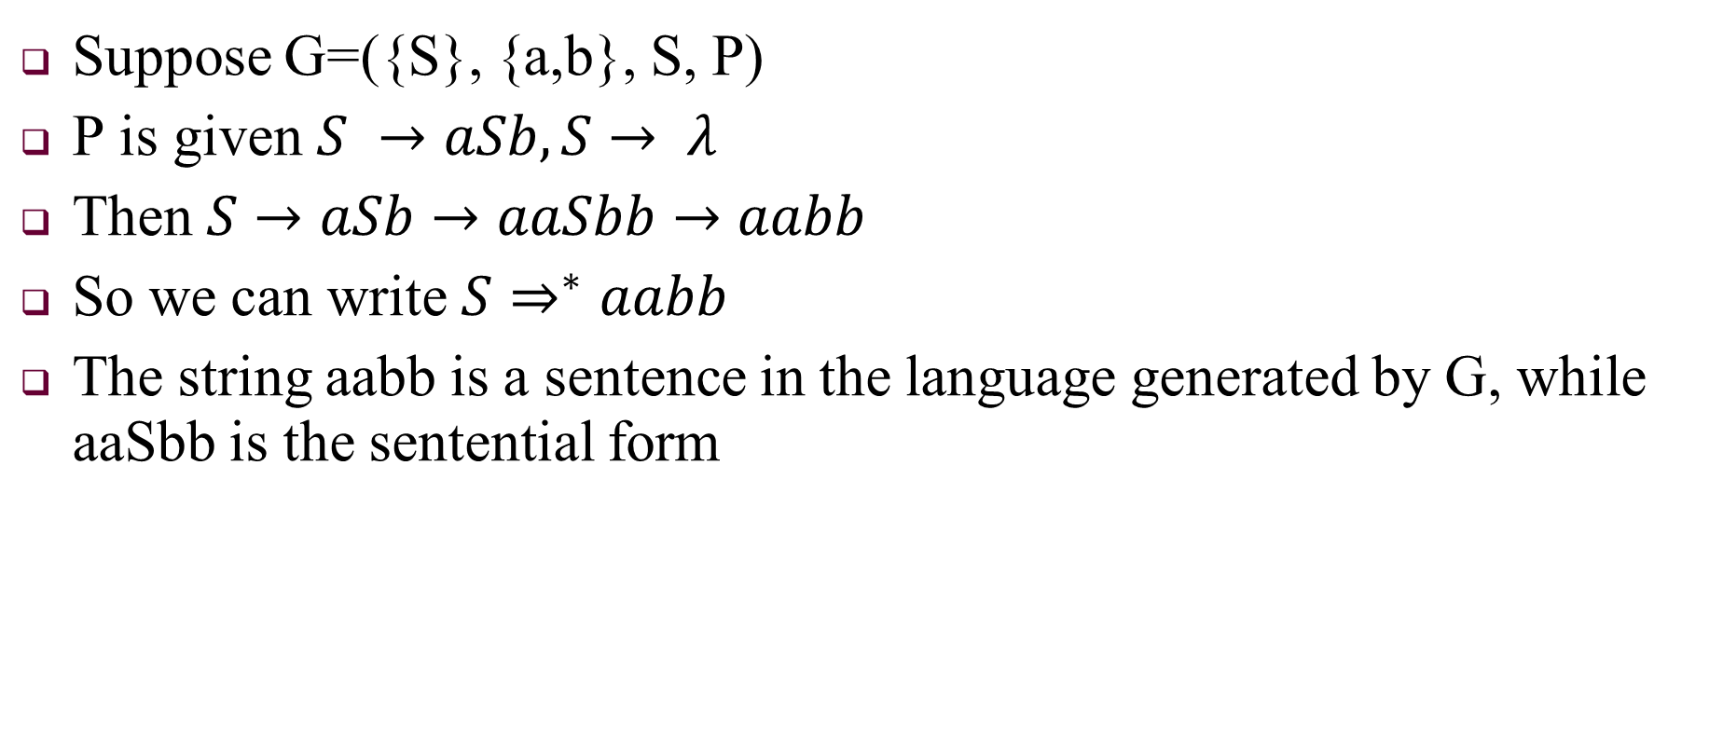
Example
Suppose G=({S}, {a,b}, S, P)
P is given $S →aSb, S→ λ$
Then $S→aSb→aaSbb→aabb$
So we can write $S⇒^{∗}aabb$
The string aabb is a sentence in the language generated by G, while aaSbb is the sentential form

Slide 14
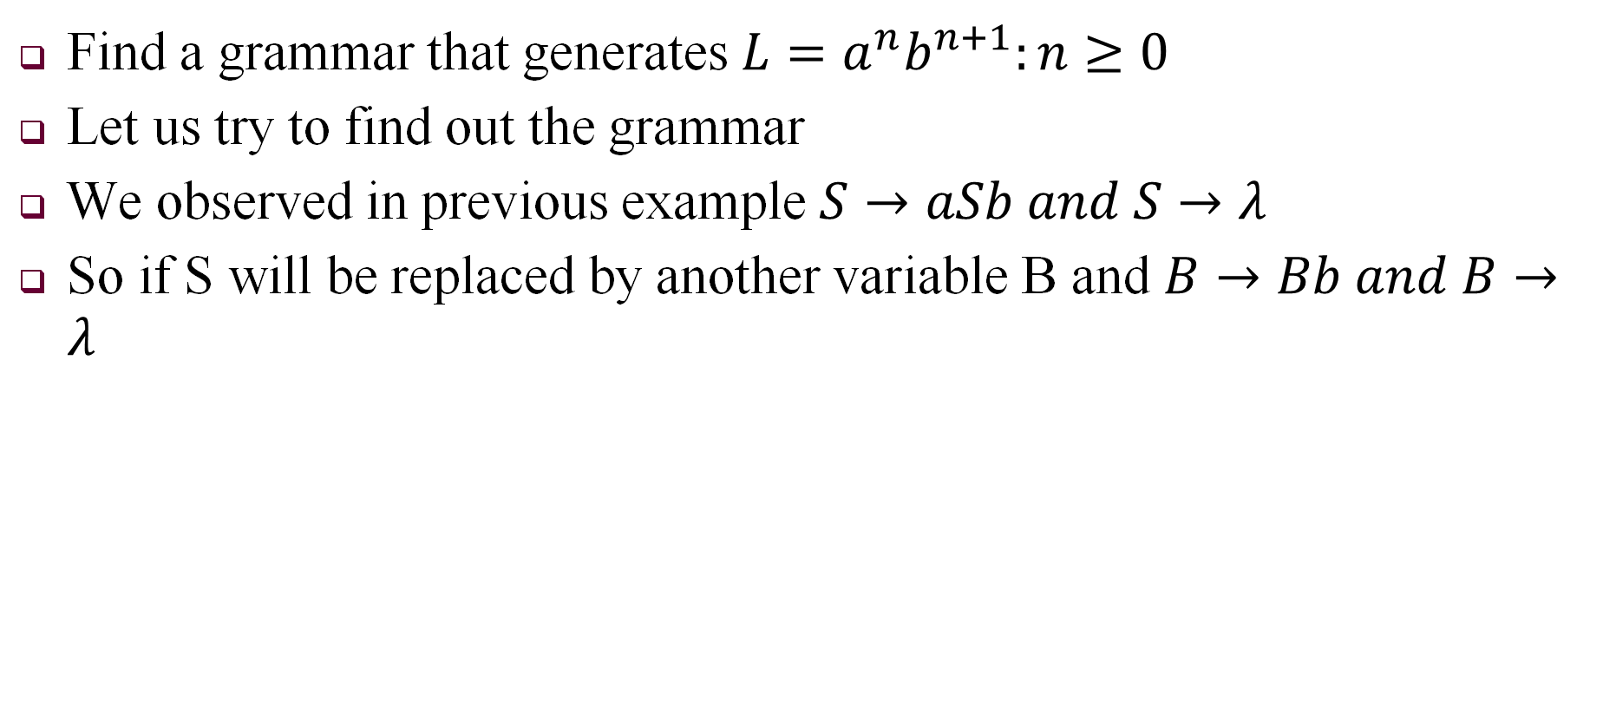
Find Grammar
Find a grammar that generates $L=a^{n}b^{n+1}:n≥0$
Let us try to find out the grammar
We observed in previous example $S→aSb and S→λ$
So if S will be replaced by another variable B and $B→Bb and B→λ$

Slide 15
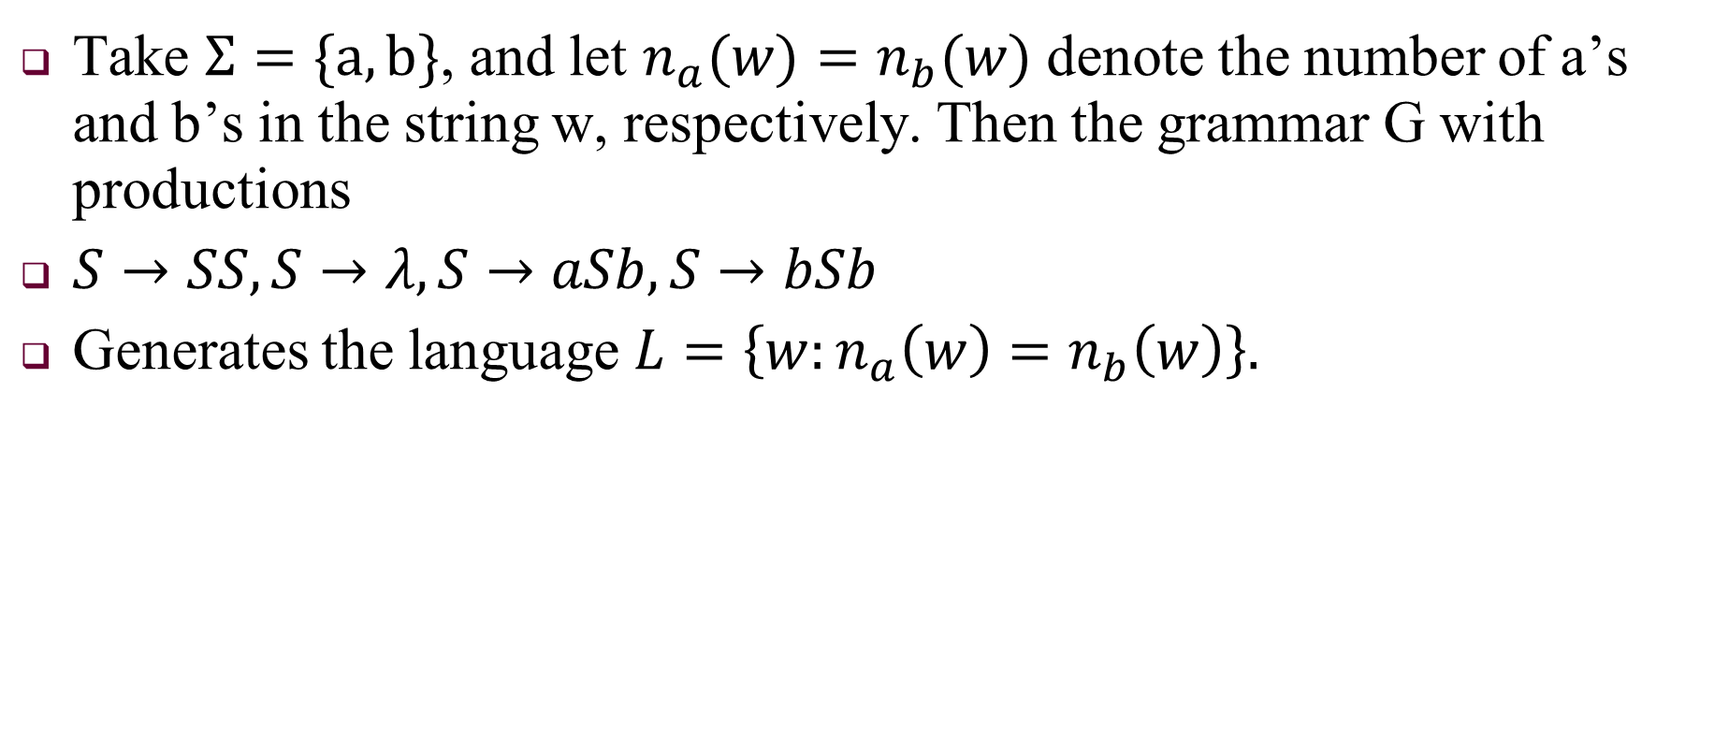
Language Generation
Take $Σ=\{a,b\}$, and let $n_{a}(w)=n_{b}(w)$ denote the number of a’s and b’s in the string w, respectively. Then the grammar G with productions
$S→SS, S→λ, S→aSb, S→bSb$
Generates the language $L=\left\{w:n_{a}\left(w\right)=n_{b}\left(w\right)\right\}.$

Slide 16
Exercise
Find grammars for ∑ = {a, b} that generate the sets of
(a) all strings with exactly one a.
(b) all strings with at least one a.

Slide 17
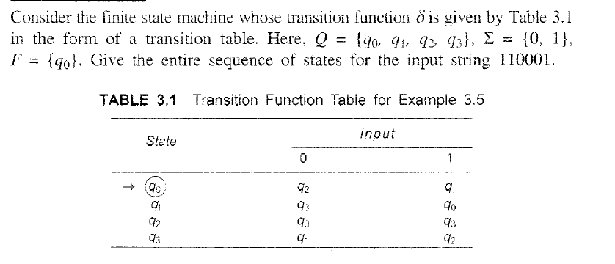
Draw State Digram

Slide 18
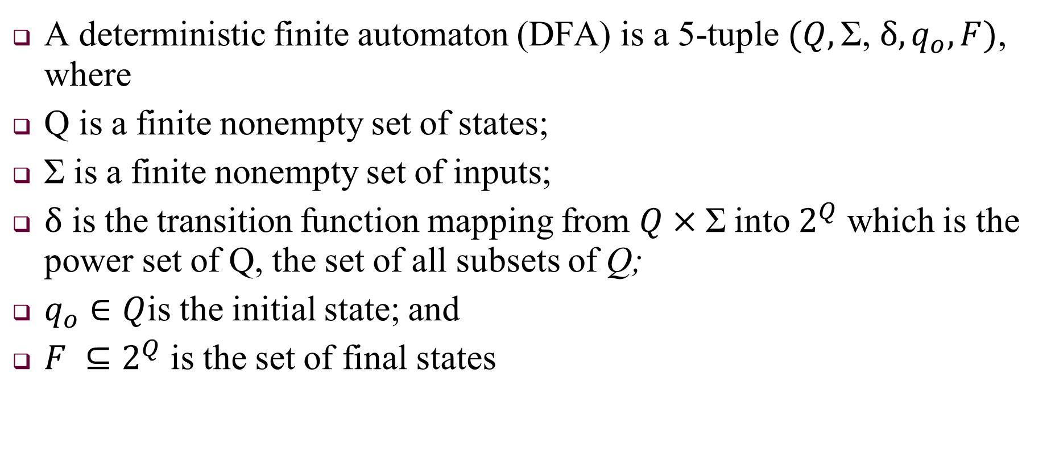
NON-Deterministic Finite Automata
A deterministic finite automaton (DFA) is a 5-tuple $(Q,\text{Σ}\text{, }δ, q_{o}, F)$, where
Q is a finite nonempty set of states;
$\text{Σ}$ is a finite nonempty set of inputs;
$δ$ is the transition function mapping from $Q×\text{Σ}$into $2^{Q}$ which is the power set of Q, the set of all subsets of Q;
$q_{o}∈Q$is the initial state; and
$F ⊆2^{Q}$ is the set of final states

Slide 19
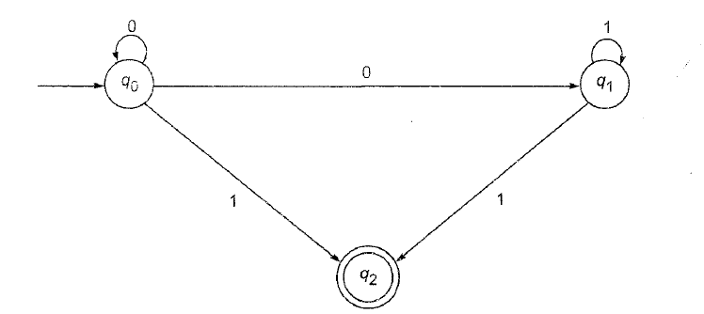
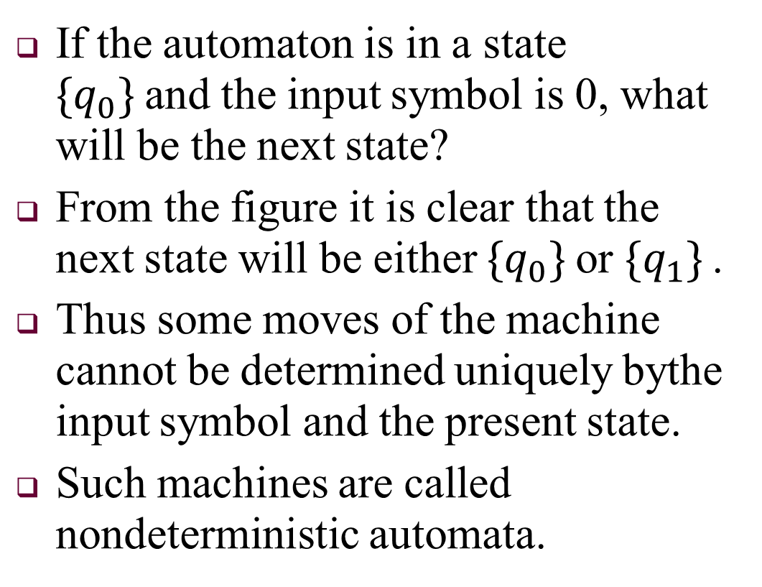
NONDETERMINISTIC FINITE STATE MACHINES
If the automaton is in a state $\{q_{0}\}$and the input symbol is 0, what will be the next state?
From the figure it is clear that the next state will be either $\{q_{0}\}$or $\{q_{1}\}$.
Thus some moves of the machine cannot be determined uniquely bythe input symbol and the present state.
Such machines are called nondeterministic automata.

Slide 20
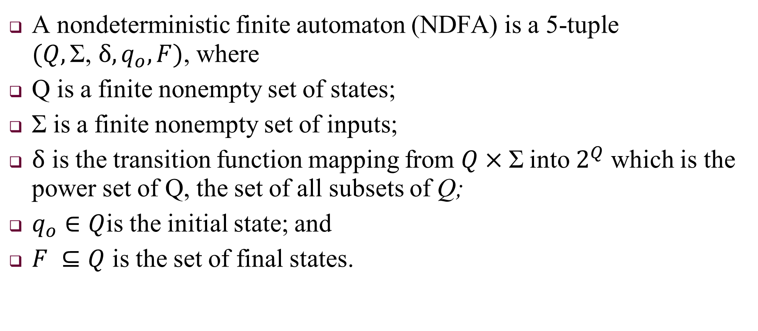
NDFA
A nondeterministic finite automaton (NDFA) is a 5-tuple $(Q,\text{Σ}\text{, }δ, q_{o}, F)$, where
Q is a finite nonempty set of states;
$\text{Σ}$ is a finite nonempty set of inputs;
$δ$ is the transition function mapping from $Q×\text{Σ}$into $2^{Q}$ which is the power set of Q, the set of all subsets of Q;
$q_{o}∈Q$is the initial state; and
$F ⊆Q$ is the set of final states.

Slide 21

DFA vs NDFA
The difference between the deterministic and nondeterministic
automata is only in $δ$. For deterministic automaton (DFA), the outcome is a state, i.e. an element of Q;
for nondeterministic automaton the outcome is a subset of Q.

Slide 22
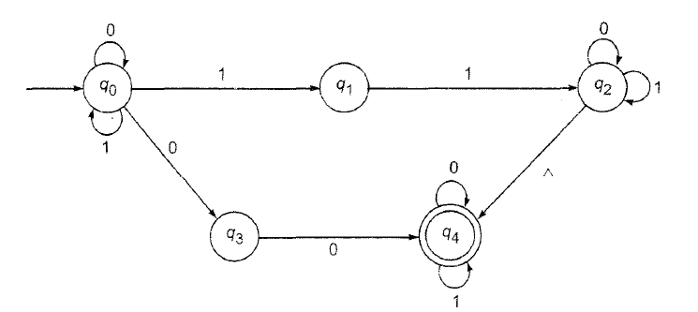
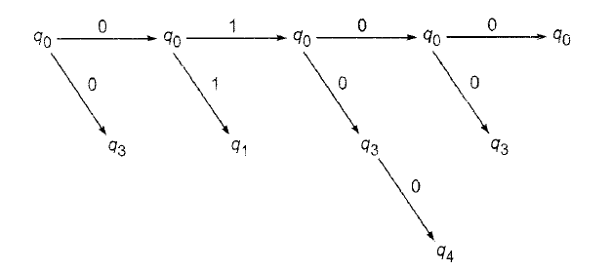
String processing by NDFA

Slide 23
Exercise
For Σ= {a,b}, onstruct dfa's that accept the sets consisting of
(a) all strings with exactly one a,
(b) all strings with at least one a,
(c) all strings with no more than three a’s,
(d) all strings with at least one a and exactly two b’s,
(e) all the strings with exactly two a’s and more than two b’s.

Slide 24
Minimization of DFA
Minimization of DFA Using Equivalence Theorem
Step-01:
Eliminate all the dead states and inaccessible states from the given DFA (if any).
Dead State: All those non-final states which transit to itself for all input symbols in ∑ are called as dead states.
Inaccessible State: All those states which can never be reached from the initial state are called as inaccessible states.
Step-02:
Draw a state transition table for the given DFA.
Transition table shows the transition of all states on all input symbols in Σ.

Slide 25
Step-03:
Now, start applying equivalence theorem.
Take a counter variable k and initialize it with value 0.
Divide Q (set of states) into two sets such that one set contains all the non-final states and other set contains all the final states.
This partition is called P₀.
Step-04:
Increment k by 1.
Find P_{k} by partitioning the different sets of P_{k-1} .

Slide 26
In each set of P_{k-1} , consider all the possible pair of states within each set and if the two states are distinguishable, partition the set into different sets in P_{k}.
Distinguishable state: Two states q₁ and q₂ are distinguishable in partition P_{k} for any input symbol ‘a’, if δ (q₁, a) and δ (q₂, a) are in different sets in partition P_{k-1}.
Step-05:
Repeat step-04 until no change in partition occurs.
In other words, when you find P_{k} = P_{k-1}, stop.

Slide 27
Step-06:
All those states which belong to the same set are equivalent.
The equivalent states are merged to form a single state in the minimal DFA.
Number of states in Minimal DFA = Number of sets in P_{k}

Slide 28
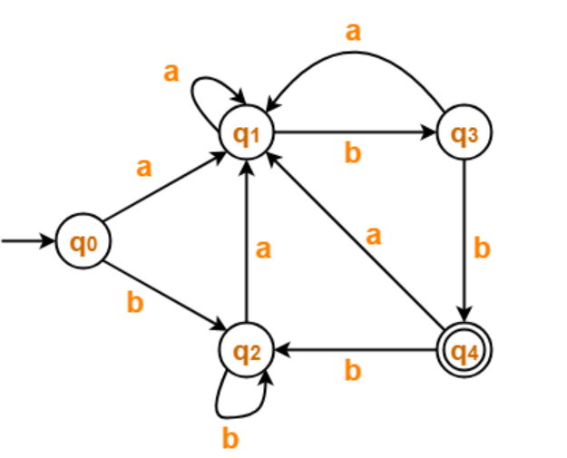
Example
Minimize the given DFA
Step-01:
The given DFA contains no dead states
and inaccessible states.
Step-02:
Draw a state transition table-
 | a | b
→q0 | q1 | q2
q1 | q1 | q3
q2 | q1 | q2
q3 | q1 | *q4
*q4 | q1 | q2

Slide 29
Step-03:
Now using Equivalence Theorem, we have-
P₀ = { q₀ , q₁ , q₂ , q₃ } { q₄ }
P₁ = { q₀ , q₁ , q₂ } { q₃ } { q₄ }
P₂ = { q₀ , q₂ } { q₁ } { q₃ } { q₄ }
P₃ = { q₀ , q₂ } { q₁ } { q₃ } { q₄ }
Since P₃ = P₂, so we stop.
From P₃, we infer that states q₀ and q₂ are equivalent and can be merged together.
So, Our minimal DFA is-

Slide 30
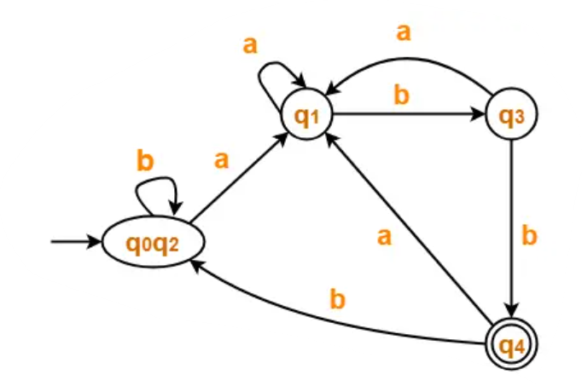
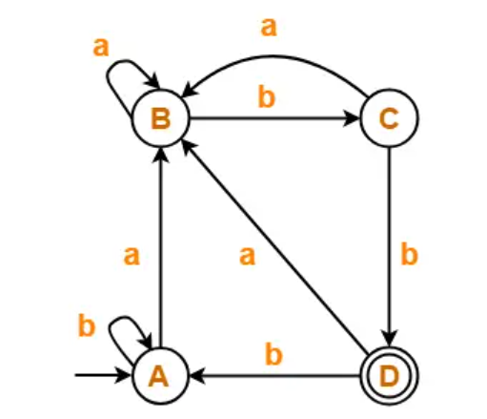

Slide 31
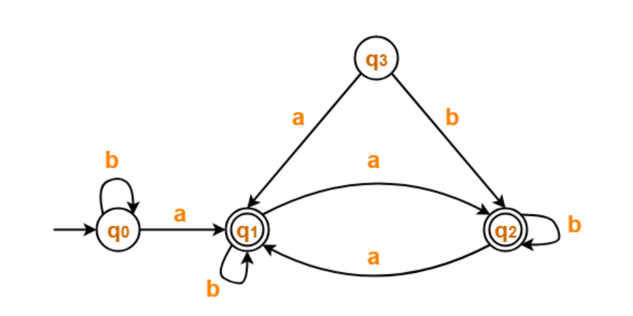
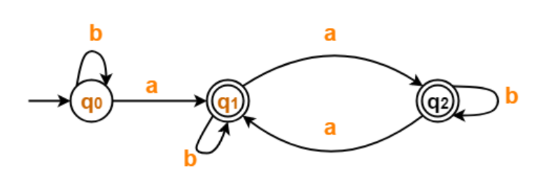
 | a | b
→q0 | *q1 | q0
*q1 | *q2 | *q1
*q2 | *q1 | *q2

Slide 32
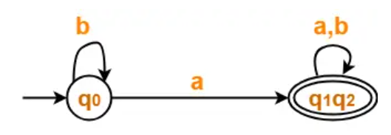
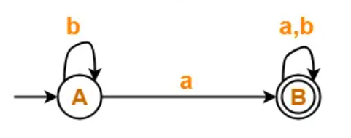
P₀ = { q₀ } { q₁ , q₂ }
P₁ = { q₀ } { q₁ , q₂ }

Slide 33
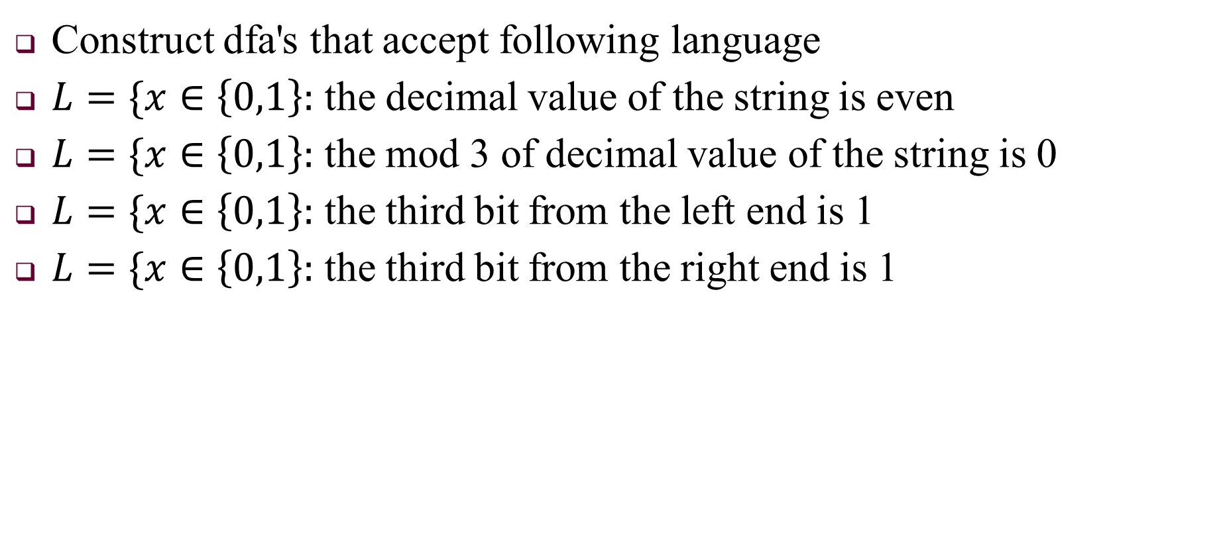
Example of DFA
Construct dfa's that accept following language
$L=\{x∈\left\{0,1\right\}:$ the decimal value of the string is even
$L=\{x∈\left\{0,1\right\}:$ the mod 3 of decimal value of the string is 0
$L=\{x∈\left\{0,1\right\}:$ the third bit from the left end is 1
$L=\{x∈\left\{0,1\right\}:$ the third bit from the right end is 1

